Slide 1
Creating Interactive OLAP Applications with MySQL Enterprise and Mondrian
Julian Hyde: Chief Architect, OLAP, at Pentaho
and Mondrian Project Founder
Wednesday, April 16th 2008

Slide 2


Agenda
Pentaho Introduction
Mondrian features and architecture
Schemas and queries
olap4j
Roadmap
Case Studies
Business Intelligence suite
Q & A

Slide 3






Pentaho Introduction
World’s most popular enterprise open source BI Suite
  2 million lifetime downloads, averaging 100K / month
  Founded in 2004: Pioneer in professional open source BI
Management - proven BI and open source veterans
  from Business Objects, Cognos, Hyperion, JBoss, Oracle, Red Hat, SAS
Board of Directors – deep expertise and proven success in open source
  Larry Augustin - founder, VA Software, helped coin the phrase “open source”
  New Enterprise Associates – investors in SugarCRM, Xensource, others
  Index Ventures – investors in MySQL, Zend, others
Widely recognized as the leader in open source BI
  Distributed worldwide by Red Hat via the Red Hat Exchange
  Embedded in next release of OpenOffice (40 million users worldwide)
Notes:
Pentaho makes the world’s most popular open source BI suite. In terms of the team, they’ve brought together experienced open source veterans like myself and others with a number of people on the engineering, support, and marketing side with a lot of experience in business intelligence. Between our customers, our projects, and our company, we’ve won a number of awards, most recently the Jolt Productivity award. We’re working with partners to rapidly expand the usage of open source in the BI market, with a global distribution agreement with Red Hat, and just last week we announced with Sun that Pentaho Reporting will be included in the next release of OpenOffice.

Slide 4
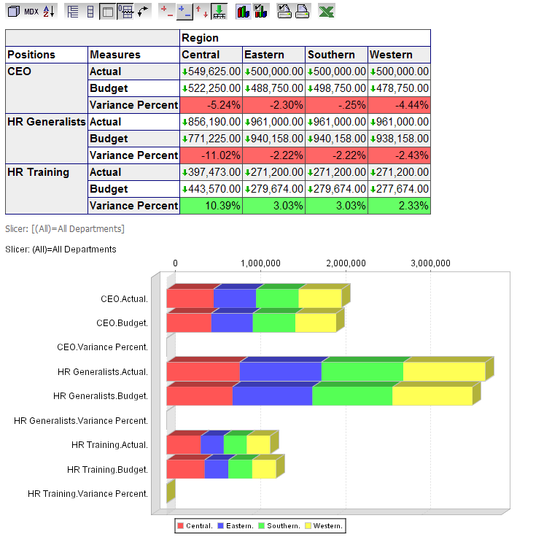

What is OLAP?
View data “dimensionally”
  i.e. Sales by region, by channel, by time period
Navigate and explore
  Ad Hoc analysis
  “Drill-down” from year to quarter
  Pivot
  Select specific members for analysis
Interact with high performance
  Technology optimized for rapid interactive response

Slide 5
Mondrian features and architecture

Slide 6

Key Features
On-Line Analytical Processing (OLAP) cubes
  automated aggregation
  speed-of-thought response times
Open Architecture
  100% Java
  J2EE
  Supports any JDBC data source
  MDX and XML/A
Analysis Viewers
  Enables ad-hoc, interactive data exploration
  Ability to slice-and-dice, drill-down, and pivot
  Provides insights into problems or successes

Slide 7

How Mondrian Extends MySQL for OLAP Applications
MySQL Provides
Data storage
SQL query execution
Heavy-duty sorting, correlation, aggregation
Integration point for all BI tools
Mondrian Provides
Dimensional view of data
MDX parsing
SQL generation
Caching
Higher-level calculations
Aggregate awareness

Slide 8
Open Architecture
Microsoft Excel
(via Spreadsheet Services)
Viewers
Open Standards (Java, XML, MDX, XML/A, SQL)
Cross Platform (Windows & Unix/Linux)
J2EE Architecture
  Server Clustering
  Fault Tolerance
Data Sources
  JDBC
  JNDI
Web Server
JPivot servlet
J2EE Application Server
File or RDBMS Repository
JPivot servlet
XML/A servlet
Mondrian
Cube
Schema
XML
Cube
Schema
XML
Cube
Schema
XML
cube
cube
cube
JDBC
JDBC
JDBC
RDBMS
RDBMS

Slide 9
<mondrian/jpivot demonstration>

Slide 10
Schemas and queries

Slide 11
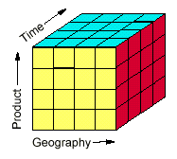
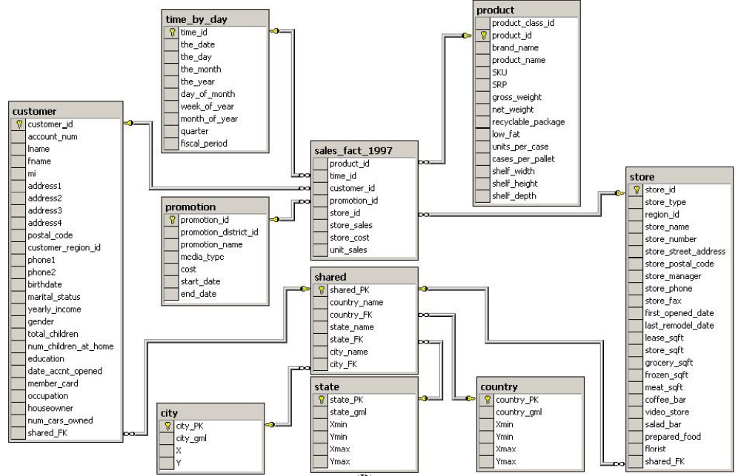
A Mondrian schema consists of…
A dimensional model (logical)
  Cubes & virtual cubes
  Shared & private dimensions
  Calculated measures in cube and in query language
  Parent-child hierarchies
… mapped onto a star/snowflake schema (physical)
  Fact table
  Dimension tables
  Joined by foreign key relationships

Slide 12
Writing a Mondrian Schema
Regular cubes, dimensions, hierarchies
Shared dimensions
Virtual cubes
Parent-child hierarchies
Custom readers
Access-control
<!-- Shared dimensions -->
<Dimension name="Region">
<Hierarchy hasAll="true“
allMemberName="All Regions">
<Table name="QUADRANT_ACTUALS"/>
<Level name="Region" column="REGION“
uniqueMembers="true"/>
</Hierarchy>
</Dimension>
<Dimension name="Department">
<Hierarchy hasAll="true“
allMemberName="All Departments">
<Table name="QUADRANT_ACTUALS"/>
<Level name="Department“
column="DEPARTMENT“
uniqueMembers="true"/>
</Hierarchy>
</Dimension>
(Refer to http://mondrian.pentaho.org/documentation/schema.php )

Slide 13
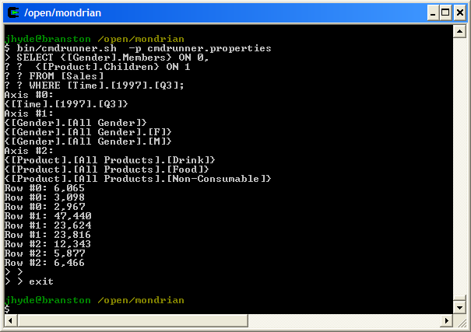
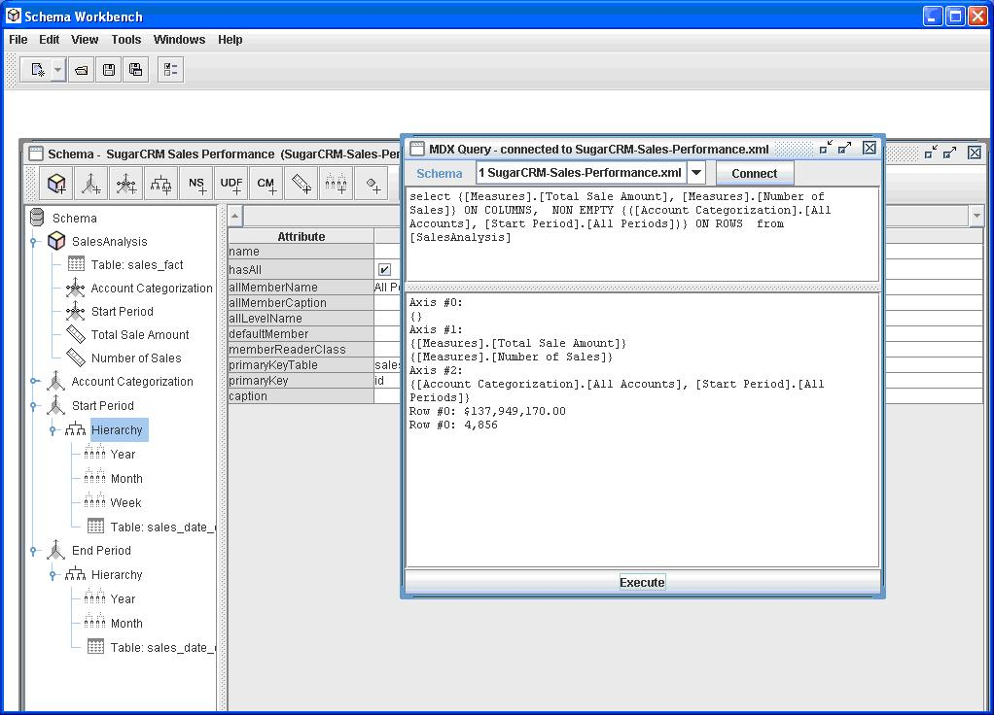
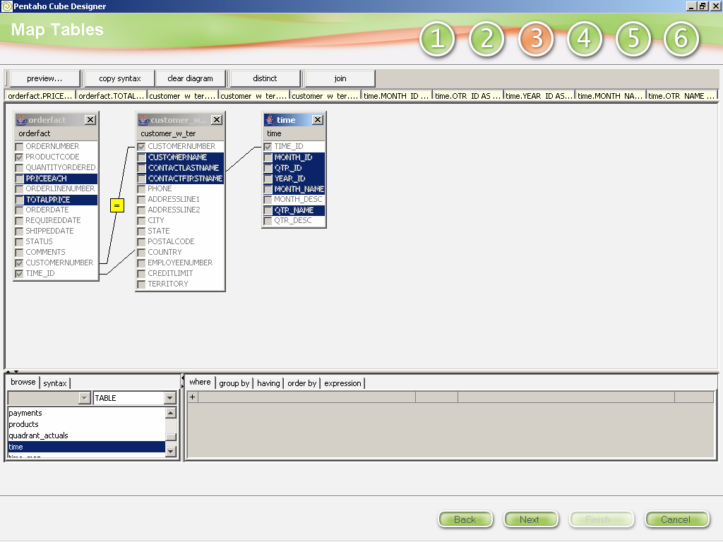
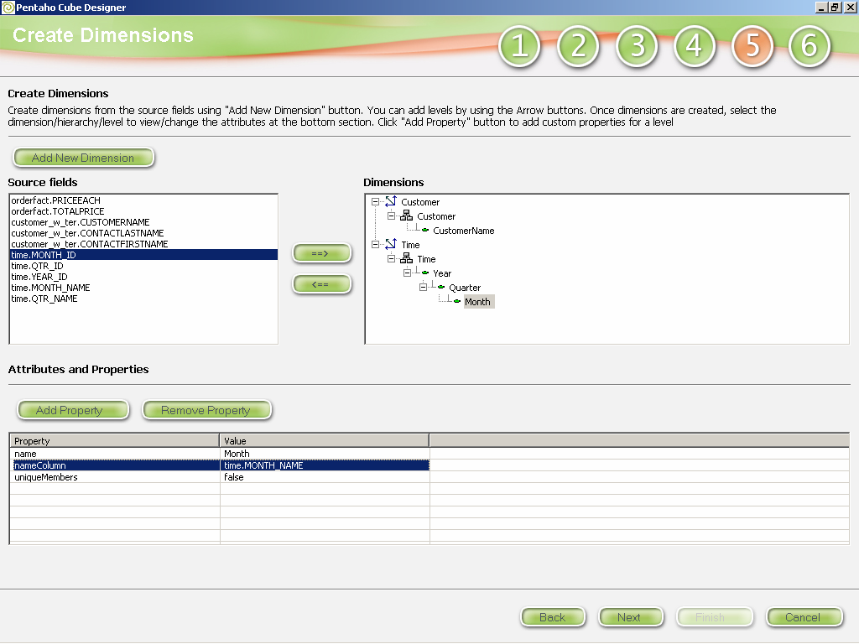
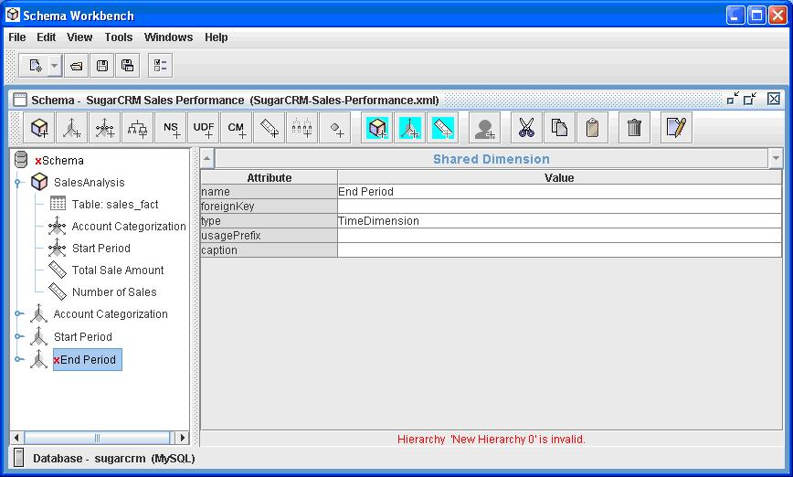
Tools
Schema Workbench
Pentaho cube designer
cmdrunner

Slide 14
MDX – Multi-Dimensional Expressions
A language for multidimensional queries
Plays the same role in Mondrian’s API as SQL does in JDBC
SQL-like syntax
… but un-SQL-like semantics
SELECT {[Measures].[Unit Sales]} ON COLUMNS,
{[Store].[USA], [Store].[USA].[CA]} ON ROWS
FROM [Sales]
WHERE [Time].[1997].[Q1]
(Refer to http://mondrian.pentaho.org/documentation/mdx.php )

Slide 15
olap4j

Slide 16
OLAP APIs
OLAP APIs that failed:
  OLAP Council’s MDAPI and OLAPI
  Sun’s JOLAP
OLAP APIs that succeeded:
  Microsoft’s OLE DB for OLAP, ADOMD, XMLA
Mondrian has an API for creating running MDX queries:
  Powerful and intuitive
  Features the MDX language
  Used by Mondrian’s XMLA provider, JPivot, other clients
  But it’s Mondrian-only

Slide 17
The problem with APIs
Client 1
Client 1
Client 2
Client 3
API 1
API 2
API 3
Server 1
Server 1
Server 2
Server 3

Slide 18
The problem with APIs #2
Client 1
Client 1
Client 2
Client 3
API 1
API 2
API 3
Server 1
Server 1
Server 2
Server 3

Slide 19
The problem with APIs – the solution
Client 1
Client 1
Client 2
Client 3
Common API
Driver 1
Driver 2
Driver 3
Server 1
Server 1
Server 2
Server 3

Slide 20
olap4j
olap4j aims to be the “JDBC for OLAP”
  An extension to JDBC
  Also inspired by ADOMD.NET
  Implementations for many OLAP servers
  Enable one client to work against many servers
  Break the ‘lock-in’
    Encourage more businesses to ‘take a chance’ on open-source
Backed by:
  Companies: Jedox, JasperSoft, Loyalty Matrix, LucidEra, Pentaho, Tensegrity, Tonbeller AG
  Projects: Halogen, JPivot, JRubik, Mondrian, OpenI, PALO
  Community at SourceForge.net

Slide 21
olap4j connecting to mondrian in-process
import org.olap4j.*;
Class.forName("mondrian.olap4j.MondrianOlap4jDriver");
OlapConnection connection =
DriverManager.createConnection(
"jdbc:mondrian:Jdbc=jdbc:mysql://localhost/foodmart;" +
"JdbcUser=foodmart;JdbcPassword=foodmart;" +
"Catalog=/WEB-INF/queries/FoodMart.xml;" +
"Role='California manager'");
OlapConnection olapConnection =
connection.unwrap(OlapConnection.class);
OlapStatement statement =
olapConnection.createOlapStatement();
OlapResult result =
statement.execute(
"SELECT {[Measures].[Unit Sales]} ON COLUMNS,\n" +
" {[Product].Members} ON ROWS\n" +
"FROM [Sales]");

Slide 22
olap4j connecting to SQL Server Analysis Services via XMLA
import org.olap4j.*;
Class.forName("org.olap4j.driver.xmla.XmlaOlap4jDriver");
OlapConnection connection =
DriverManager.createConnection(
"jdbc:xmla:Server=http://marmalade/xmla/msxisapi.dll;" +
"Catalog=FoodMart;" +
"Role='California manager'");
OlapConnection olapConnection =
connection.unwrap(OlapConnection.class);
OlapStatement statement =
olapConnection.createOlapStatement();
OlapResult result =
statement.execute(
"SELECT {[Measures].[Unit Sales]} ON COLUMNS,\n" +
" {[Product].Members} ON ROWS\n" +
"FROM [Sales]");

Slide 23
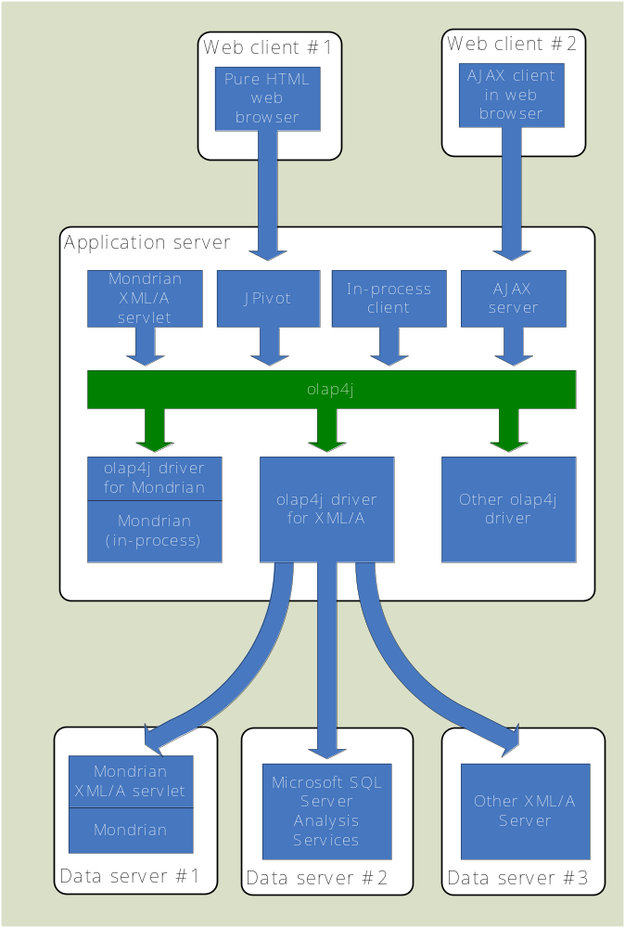
olap4j architecture
Client:
In-process
XMLA
HTML
AJAX
Server:
Mondrian in-process
Mondrian via XMLA
Microsoft SSAS via XMLA
Other OLAP server via XMLA
Other OLAP server via dedicated olap4j driver

Slide 24
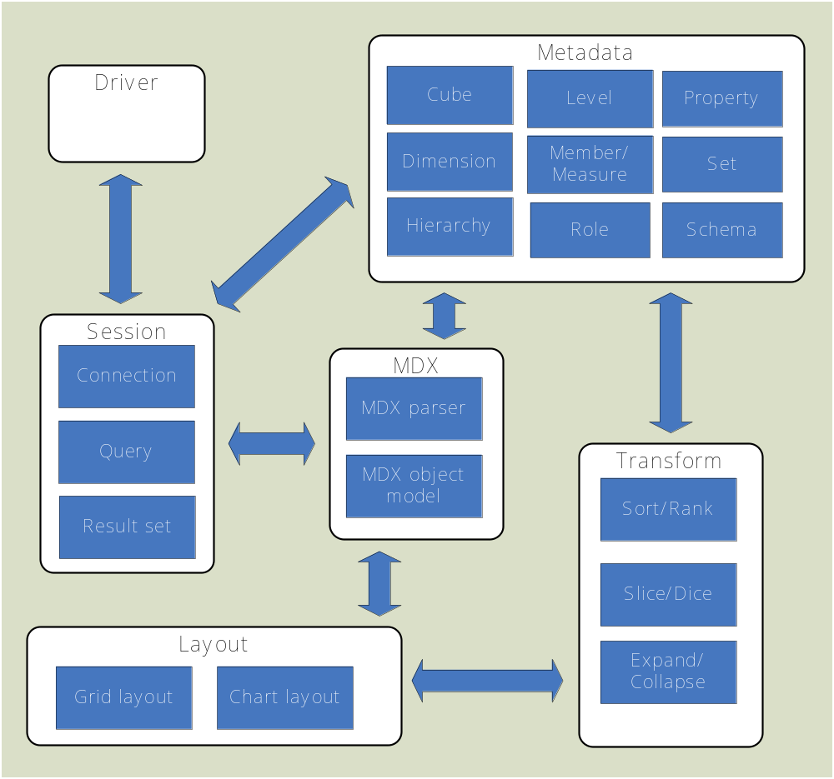
olap4 components
Driver management
Session
Metadata
MDX
Transform & layout

Slide 25
olap4j/mondrian roadmap
2006 September olap4j 0.5 (draft)
2007 October – olap4j 0.9 (beta)
2008 February – olap4j driver for XMLA
2008 July – olap4j 1.0
2007 August – mondrian 2.4
2008 March – mondrian 3.0 featuring olap4j API
2008 August – mondrian 3.1 featuring olap4j 1.0 API

Slide 26
mondrian 3.0 features
olap4j API
Rollup policy
Aggregate roles
Allow distinct-count measures to be aggregated
Improve dimension sharing
JNDI in connect string
Over 90 new MDX functions

Slide 27
Halogen
Pentaho incubator project
Slice/dice OLAP client
Built using GWT → AJAX
Built on olap4j → portable across OLAP servers

Slide 28
<halogen demonstration>

Slide 29
Case studies

Slide 30


Case Study: Frontier Airlines
Frontier Airlines
Key Challenges
Understanding and optimizing fares to ensure
  Maximum occupancy (no empty seats)
  Maximum profitability (revenue per seat)
Pentaho Solution
Pentaho Analysis (Mondrian)
Chose Open Source RDBMS and Mondrian over Oracle
500 GB of data, 6 server cluster
Results
Comprehensive, integrated analysis to set strategic pricing
Improved per-seat profitability (amount not disclosed)
Why Pentaho
Rich analytical and MDX functionality
Cost of ownership
“The competition is intense in the airline industry and Frontier is committed to staying ahead of the curve by leveraging technology that will help us offer the best prices and the best flight experience…. [the application] fits right in with our philosophy of providing world-class performance at a low price.”

Slide 31

Pentaho at Loma Linda University Health Care
Leading Healthcare Provider
Key Challenges
Providing analytics for billing and operations supporting 500,000 patients and 600 doctors
Pentaho Solution
Pentaho Analysis Subscription
Selected over Business Objects and Cognos
Microsoft Windows Server with SQL Server
Integrated with LDAP and Active Directory
Results
Comprehensive analysis of time periods, services provided, billing groups, physicians
Centralized, secured, consistent information delivery (versus prior Excel-based system)
Ability to drill and analyze down to the individual patient level
Why Pentaho
Open standards support and ease of integration
Cost of ownership
“Pentaho Customer Support has been exceptional. This is a strategic application at LLUHC, and working with Pentaho has accelerated our deployment and improved our overall application delivery.”
Notes:
Highlights:
Upgrade from Access- and Excel-based management system put in place before the organization grew
Detailed analysis including more than 500,000 leaf-level members in the patient dimension
Working with Pentaho via subscription services helped them deploy a better application more quickly, and allowed them to deliver Single Sign On integrated with both Microsoft Active Directory and ACEGI

Slide 32
The big picture

Slide 33

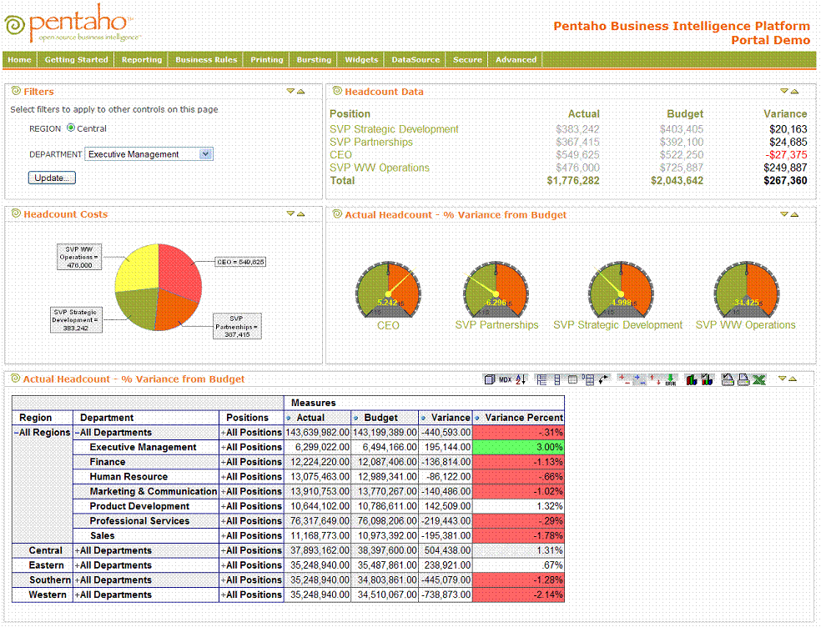
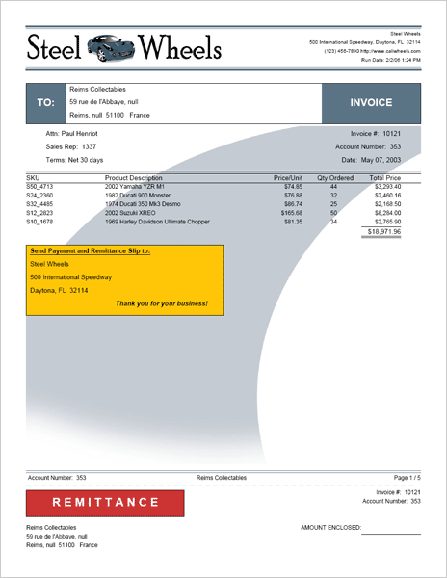
Business Intelligence Suite
Mondrian OLAP
Analysis tools:
  Pivot table
  Charting
  Dashboards
ETL (extract/transform/load)
Integration with operational reporting
Integration with data mining
Actions on operational data
Design/tuning tools

Slide 34
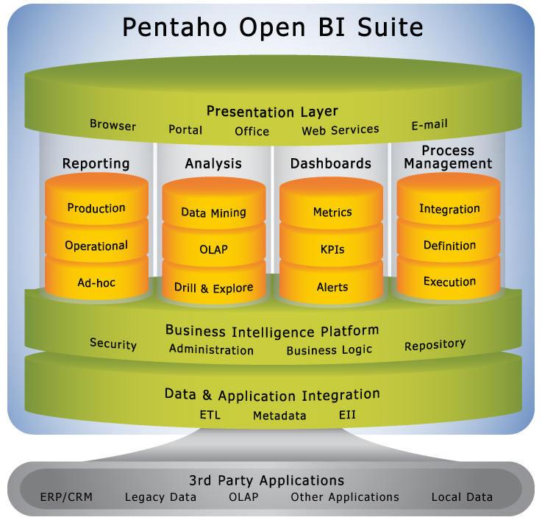
Pentaho Open Source BI Offerings
All available in a Free Open Source license

Slide 35






A Sample of Joint MySQL-Pentaho Users
“Pentaho provided a robust, open source platform for our sales reporting application, and the ongoing support we needed. The experts at OpenBI provided outstanding services and training, and allowed us to deploy and start generating results very quickly.”
“We selected Pentaho for its ease-of-use. Pentaho addressed many of our requirements -- from reporting and analysis to dashboards, OLAP and ETL, and offered our business users the Excel-based access that they wanted.”

Slide 36
Next Steps and Resources
Contact Information
  Julian Hyde, Chief Architect, jhyde@pentaho.com
More information http://www.pentaho.org and http://mondrian.pentaho.org
Pentaho Community Forum http://community.pentaho.org
  Go to Developer Zone
  Discussions
Pentaho BI Platform including Mondrian http://www.pentaho.org/download/latest
Mondrian OLAP Library only
  http://sourceforge.net/project/showfiles.php?group_id=35302

Slide 37
Thank you for attending!

